Slide 1
Malware Protection
using
Reverse Engineering
UE20CS390B Capstone Phase-2 Review-3
Project ID : PW23_HBP_01
Guide : Prof. Prasad B Honnavalli
Co-Guide : Asst. Prof. Sushma E
Team : Pavan R Kashyap (PES1UG20CS280)
Phaneesh R Katti (PES1UG20CS281)
Hrishikesh Bhat P (PES1UG20CS647)
Pranav K Hegde (PES1UG20CS672)

Slide 2


Control Flow
Malware Protection Using Reverse Engineering
Review - 3
About
Research Publications
Project Abstract and Scope
Our published work
Project Recap
Conclusion & Future Plan
Milestones Accomplished
Our journey so far for Review - 3
What’s next?
Pavan-R-Kashyap_Phaneesh-R-Katti_Hrishikesh-Bhat-P_Pranav-K-Hegde

Slide 3
Control Flow
Malware Protection Using Reverse Engineering
Review - 3
Research Publications
About
Project Abstract and Scope
Our published work
Conclusion & Future Plan
Project Recap
Milestones Accomplished
Our journey so far for Review - 3
What’s next?
Pavan-R-Kashyap_Phaneesh-R-Katti_Hrishikesh-Bhat-P_Pranav-K-Hegde

Slide 4
Project Abstract
Malware Protection Using Reverse Engineering
The objective of this capstone project is to conduct a comprehensive study of famous malware like “WannaCry”, “Stuxnet” to name a few, and present an analysis of their functionality, tactics, and techniques.
Various static and dynamic tools like Ghidra, Procmon will be investigated, to compile detailed reports suitable for both technical and non-technical audience.
Furthermore, the project will encompass the development of strategies and guidelines for mitigating potential malware threats, while also providing insights into an attacker's mindset.
Pavan-R-Kashyap_Phaneesh-R-Katti_Hrishikesh-Bhat-P_Pranav-K-Hegde

Slide 5
Project Scope
Malware Protection Using Reverse Engineering
Dynamic Analysis
Identifying Tools
Examine Prevelant Malware
Pavan-R-Kashyap_Phaneesh-R-Katti_Hrishikesh-Bhat-P_Pranav-K-Hegde

Slide 6

Control Flow
Malware Protection Using Reverse Engineering
Review - 3
Research Publications
About
Project Abstract and Scope
Our published work
Conclusion & Future Plan
Project Recap
Milestones Accomplished
Our journey so far for Review - 3
What’s next?
Pavan-R-Kashyap_Phaneesh-R-Katti_Hrishikesh-Bhat-P_Pranav-K-Hegde

Slide 7
Control Flow
Malware Protection Using Reverse Engineering
Review - 3
Research Publications
About
Project Abstract and Scope
Our published work
Conclusion & Future Plan
Project Recap
Milestones Accomplished
Our journey so far for Review - 3
What’s next?
Pavan-R-Kashyap_Phaneesh-R-Katti_Hrishikesh-Bhat-P_Pranav-K-Hegde

Slide 8
Phase 02 Milestone Recap
Malware Protection Using Reverse Engineering
Fileless Malware
Macros
01
02
03
04
Process Hooking
Double Pulsar
Pavan-R-Kashyap_Phaneesh-R-Katti_Hrishikesh-Bhat-P_Pranav-K-Hegde

Slide 9
Milestone Recap 1
Malware Protection Using Reverse Engineering
A macro is a concise and predefined sequence of instructions or commands, essentially a small program, specifically crafted to automate repetitive tasks within Microsoft Office applications.
Word macros enable the creation of customized actions, such as formatting, text insertion, or complex document manipulations, streamlining workflows for increased productivity.
Macros
01
Pavan-R-Kashyap_Phaneesh-R-Katti_Hrishikesh-Bhat-P_Pranav-K-Hegde

Slide 10
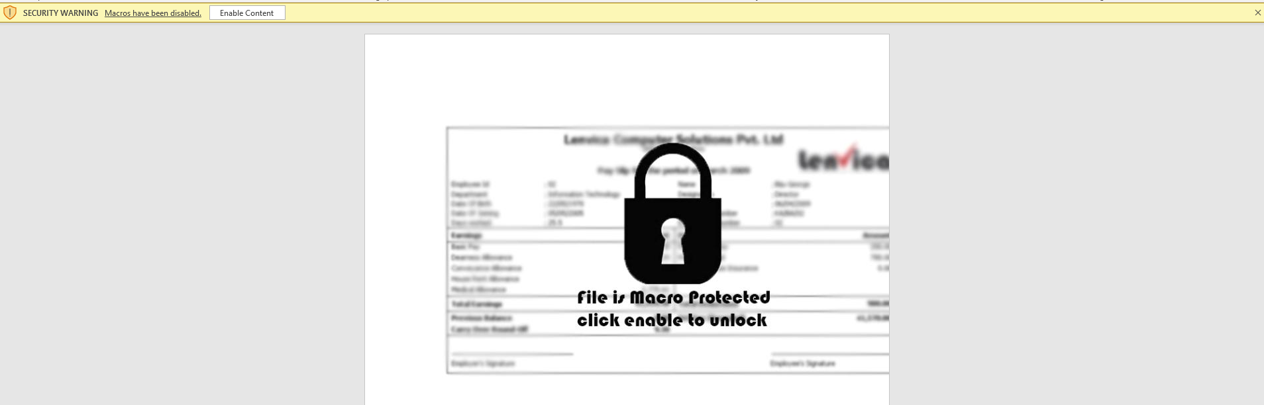
Malware Protection Using Reverse Engineering
Quick Recap - Macros
We see a security warning which prevents macros from executing.
We must enable macros for analysis purpose. However, enabling might execute the script while opening the word document even before analyzing the script. Hence, we shall enable it after analyzing script.
Pavan-R-Kashyap_Phaneesh-R-Katti_Hrishikesh-Bhat-P_Pranav-K-Hegde

Slide 11
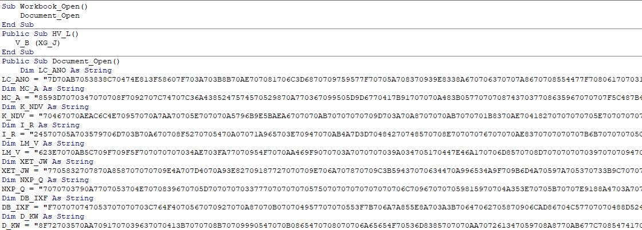
Quick Recap - Macros
Malware Protection Using Reverse Engineering
Analysing the Macro VBA Script
Pavan-R-Kashyap_Phaneesh-R-Katti_Hrishikesh-Bhat-P_Pranav-K-Hegde

Slide 12
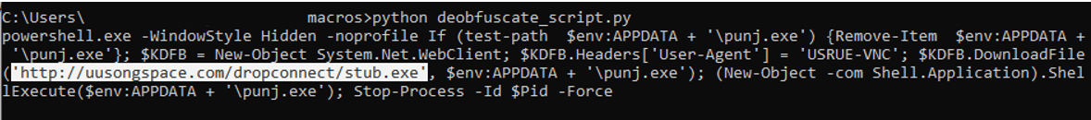
Quick Recap - Macros
Malware Protection Using Reverse Engineering
Analysing the Macro VBA Script :
Pavan-R-Kashyap_Phaneesh-R-Katti_Hrishikesh-Bhat-P_Pranav-K-Hegde

Slide 13
Quick Recap - Macros
Malware Protection Using Reverse Engineering
The script initiates a hidden instance of PowerShell without loading a user profile. It checks for the existence of a file named "punj.exe" in the user's APPDATA directory and removes it if present.
The script then downloads a file from a C2 URL ('http://uusongspace.com/dropconnect/stub.exe'), disguises its origin with a custom User-Agent header, saves it as "punj.exe," and executes the downloaded program.
Pavan-R-Kashyap_Phaneesh-R-Katti_Hrishikesh-Bhat-P_Pranav-K-Hegde

Slide 14
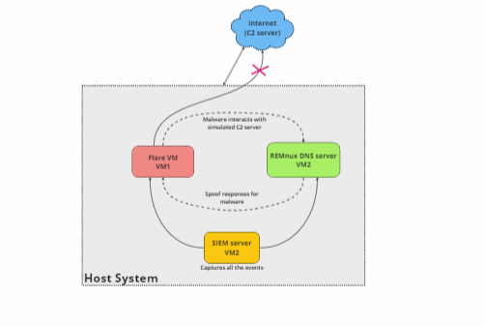
Quick Recap - Macros
Malware Protection Using Reverse Engineering
General working Architecture
Pavan-R-Kashyap_Phaneesh-R-Katti_Hrishikesh-Bhat-P_Pranav-K-Hegde
Notes:
Need to be updated

Slide 15
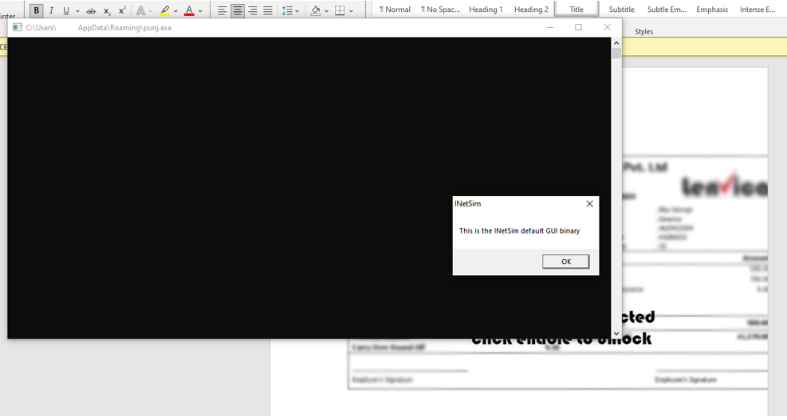
Quick Recap – Macros Outpout Screen
Malware Protection Using Reverse Engineering
Pavan-R-Kashyap_Phaneesh-R-Katti_Hrishikesh-Bhat-P_Pranav-K-Hegde
Notes:
Need to be updated

Slide 16
Quick Recap – Macros Proposed Mitigation Strategies
Malware Protection Using Reverse Engineering
Disable Macros: Disable macros in documents by default, especially in email attachments. Users should only enable them from trusted sources.
Software Updates: Regularly update operating systems, software applications, and antivirus tools. Patches often include security fixes to protect against known vulnerabilities.
User Education: Educate users about the dangers of downloading and executing files from unknown or untrusted sources. Teach them how to identify phishing emails and suspicious websites.
Secure Authentication Practices: Enforce the use of strong and unique passwords, multi-factor authentication (MFA), and access controls to safeguard sensitive information and prevent unauthorized access.
Pavan-R-Kashyap_Phaneesh-R-Katti_Hrishikesh-Bhat-P_Pranav-K-Hegde

Slide 17
Milestone Recap 2
Malware Protection Using Reverse Engineering
02
What is Process Hooking?
Process hooking in the context of malware refers to the technique of intercepting and altering the behavior of application programming interfaces (APIs) used by software applications.
Malicious actors employ API hooking as a stealthy method to manipulate system or application functionality, allowing them to gain unauthorized access, monitor user activities, or evade detection.
By injecting code to intercept API calls, malware can redirect program flow, modify data, or even substitute legitimate API responses with malicious ones.
Process Hooking
Pavan-R-Kashyap_Phaneesh-R-Katti_Hrishikesh-Bhat-P_Pranav-K-Hegde

Slide 18
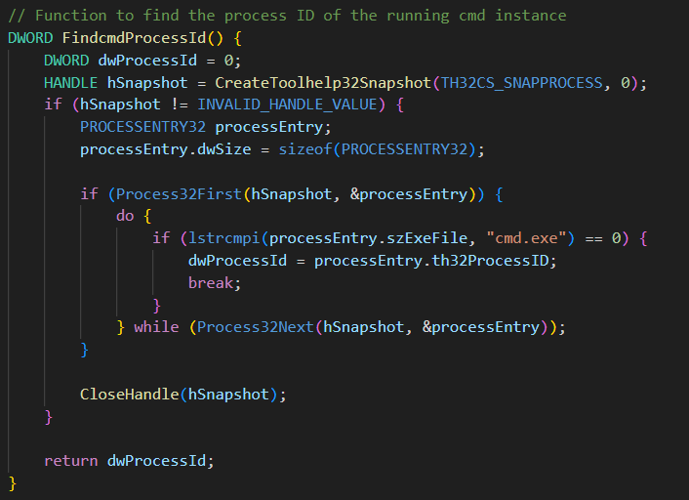
Quick Recap – Process Hooking
Malware Protection Using Reverse Engineering
Search for currently running CMD Process
Pavan-R-Kashyap_Phaneesh-R-Katti_Hrishikesh-Bhat-P_Pranav-K-Hegde
Notes:
Need to be updated

Slide 19
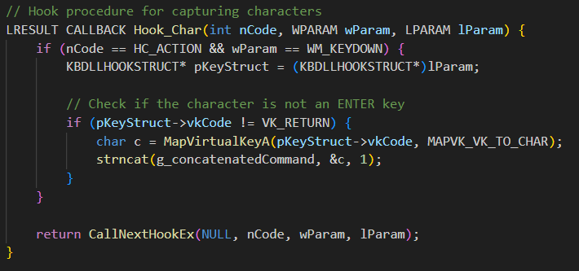
Quick Recap – Process Hooking
Malware Protection Using Reverse Engineering
Hooking Characters on Key-Down
Pavan-R-Kashyap_Phaneesh-R-Katti_Hrishikesh-Bhat-P_Pranav-K-Hegde
Notes:
Need to be updated

Slide 20
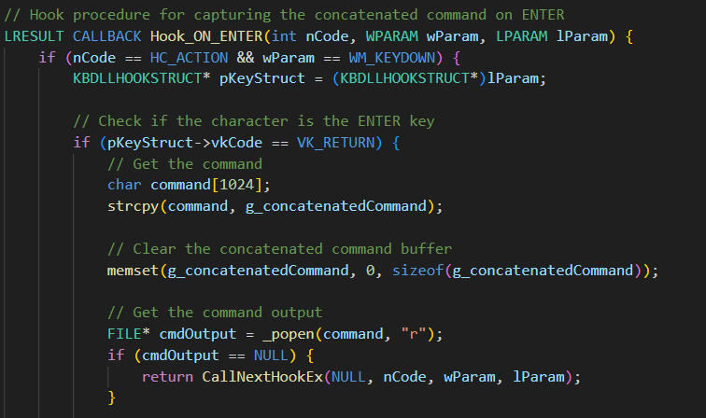
Quick Recap –Hooking - Code
Malware Protection Using Reverse Engineering
Pavan-R-Kashyap_Phaneesh-R-Katti_Hrishikesh-Bhat-P_Pranav-K-Hegde
Notes:
Need to be updated

Slide 21
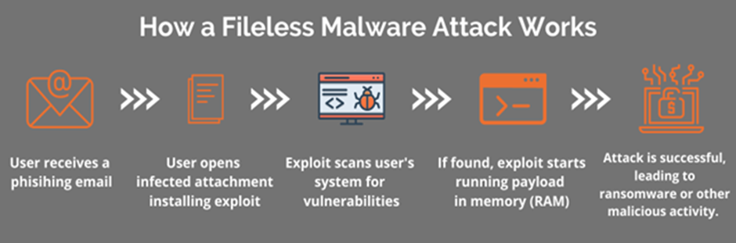
Milestone Recap 3
Malware Protection Using Reverse Engineering
Fileless Malware
Fileless malware is malicious code that works directly within a computer’s memory instead of the hard drive. It uses legitimate, otherwise benevolent programs to compromise your computer instead of malicious files.
It is “Fileless” in the sense that no files are downloaded to your hard drive. Fileless malware hides by using applications administrators would usually trust.
03
Pavan-R-Kashyap_Phaneesh-R-Katti_Hrishikesh-Bhat-P_Pranav-K-Hegde

Slide 22
Milestone Recap 4
Malware Protection Using Reverse Engineering
A DoublePulsar attack works by silently installing a dangerous backdoor implant on your PC, which attackers can use to bypass your PC's security and access your system without detection.
After gaining access to your system, the attacker can plant malware, or steal your personal data. The attackers would get remote control over the system to deploy the Wannacry 2.0 payload through this attack.
04
Double Pulsar (DP)
Pavan-R-Kashyap_Phaneesh-R-Katti_Hrishikesh-Bhat-P_Pranav-K-Hegde

Slide 23
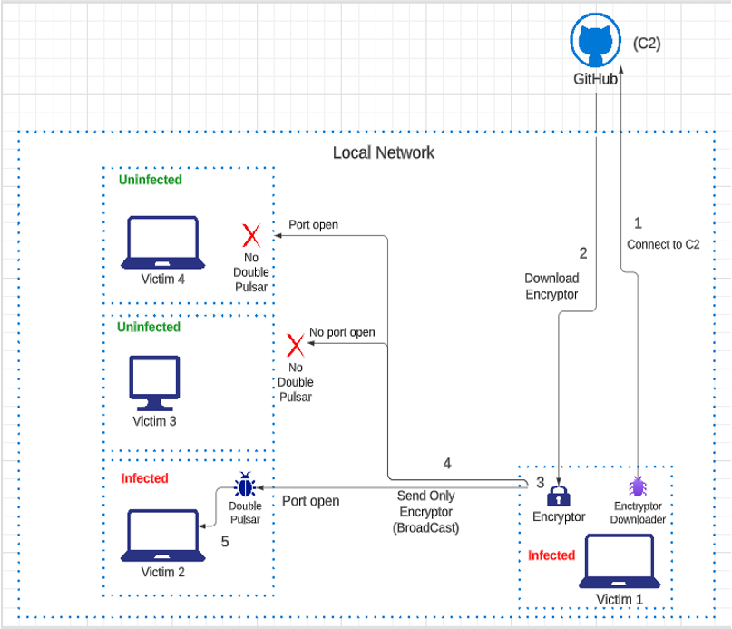
Quick Recap – DP Arch.
Malware Protection Using Reverse Engineering
Pavan-R-Kashyap_Phaneesh-R-Katti_Hrishikesh-Bhat-P_Pranav-K-Hegde

Slide 24
Control Flow
Malware Protection Using Reverse Engineering
Review - 3
Research Publications
About
Project Abstract and Scope
Our published work
Conclusion & Future Plan
Project Recap
Milestones Accomplished
Our journey so far for Review - 3
What’s next?
Pavan-R-Kashyap_Phaneesh-R-Katti_Hrishikesh-Bhat-P_Pranav-K-Hegde

Slide 25
Control Flow
Malware Protection Using Reverse Engineering
Review - 3
Research Publications
About
Project Abstract and Scope
Our published work
Conclusion & Future Plan
Project Recap
Milestones Accomplished
Our journey so far for Review - 3
What’s next?
Pavan-R-Kashyap_Phaneesh-R-Katti_Hrishikesh-Bhat-P_Pranav-K-Hegde

Slide 26
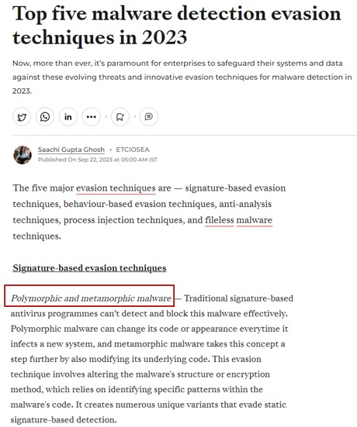
Statistics on Polymorphic & Metamorphic Samples
Malware Protection Using Reverse Engineering
Pavan-R-Kashyap_Phaneesh-R-Katti_Hrishikesh-Bhat-P_Pranav-K-Hegde

Slide 27
Polymorphic Malware
Malware Protection Using Reverse Engineering
Pavan-R-Kashyap_Phaneesh-R-Katti_Hrishikesh-Bhat-P_Pranav-K-Hegde

Slide 28
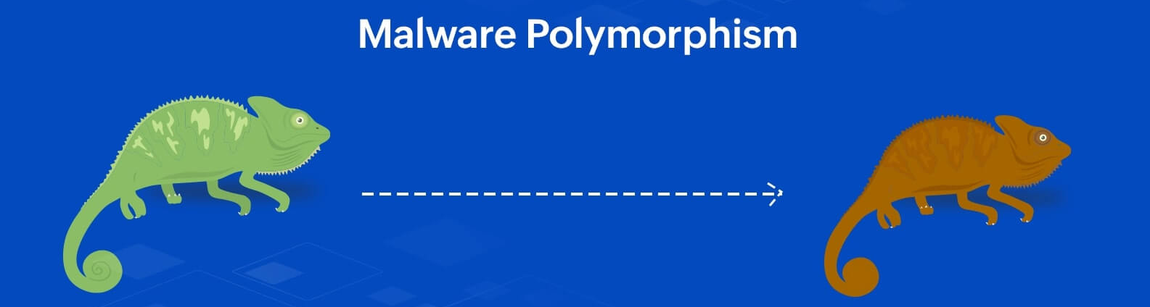
Polymorphic Malware
Malware Protection Using Reverse Engineering
Polymorphic malware samples are those malware samples that change their appearance (code structure) for each infection whilst retaining their core functionality.
They use encryption and obfuscation techniques to hide the core functionality.
Analogy: There is a mannequin (core functionality). You put on a new coat to it every day (outward appearance)
Pavan-R-Kashyap_Phaneesh-R-Katti_Hrishikesh-Bhat-P_Pranav-K-Hegde

Slide 29
Polymorphic Malware
Malware Protection Using Reverse Engineering
Polymorphic engines, code sections that generate polymorphic virus variants are usually part of the malware source code.
The engine is responsible for extracting the core functionality of the malware sample and then morphing it, using the techniques discussed before, generating an encrypted or morphed variant of the original sample.
Each polymorphic variant contains a decryptor section attached to it that contains the code to decrypt or de-obfuscate the polymorphic variant and load the core functionality onto the memory.
Pavan-R-Kashyap_Phaneesh-R-Katti_Hrishikesh-Bhat-P_Pranav-K-Hegde

Slide 30
Polymorphic Malware
Malware Protection Using Reverse Engineering
When a new copy of the sample must be dropped somewhere, the polymorphic engine fetches the original source code (that is decrypted) and then morphs it again using a new key.
A new key (key rotation) ensures that each polymorphic variant appears significantly different from its predecessor, thereby achieving its purpose of concealing the core functionality and appearing different each time.
Pavan-R-Kashyap_Phaneesh-R-Katti_Hrishikesh-Bhat-P_Pranav-K-Hegde

Slide 31
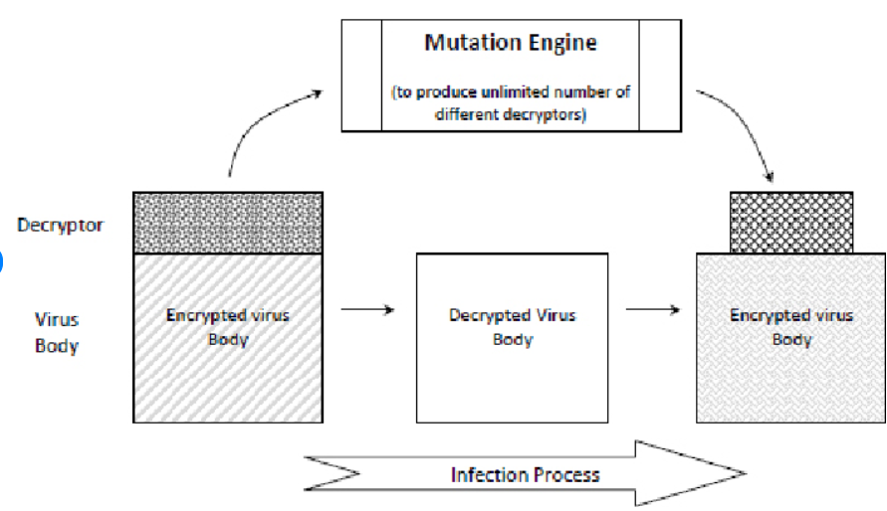
Polymorphic Malware
Malware Protection Using Reverse Engineering
Polymorphic engines and decryptors usually take up significant space. They make up nearly 80-90% of the entire malware source code.
Image Source; https://www.researchgate.net/figure/Polymorphic-virus-structure_fig4_235641122
General Working Architecture
of Polymorphic Malware
Pavan-R-Kashyap_Phaneesh-R-Katti_Hrishikesh-Bhat-P_Pranav-K-Hegde

Slide 32
Polymorphic Malware
Malware Protection Using Reverse Engineering
High-level working of the malware sample mainly has 2 different malware scripts n play:
Victim side script which contains encrypted payload and performs malicious actions.
Attacker side polymorphic engine that generates polymorphic variants.
Victim side script, when executed, corrupts word documents by appending junk value and connects to attacker side engine to download a variant in a different folder path.
Victim side script sections:
The decryptor code
The encrypted payload .
Pavan-R-Kashyap_Phaneesh-R-Katti_Hrishikesh-Bhat-P_Pranav-K-Hegde

Slide 33
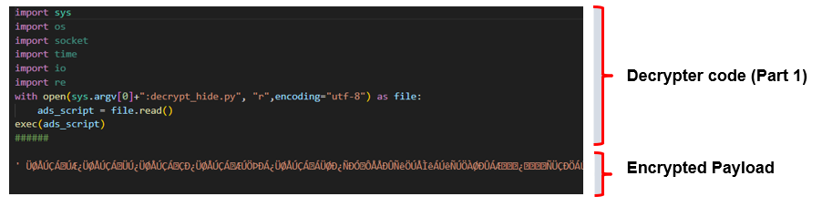
Polymorphic Malware
Malware Protection Using Reverse Engineering
Victim side Decryptor code :
Each polymorphic variant contains an encrypted payload and a decryptor code to extract the core code functionality. The algorithm to decrypt the payload is stored in the Alternate Data Stream
Decryptor Code (Part 1)
Pavan-R-Kashyap_Phaneesh-R-Katti_Hrishikesh-Bhat-P_Pranav-K-Hegde

Slide 34
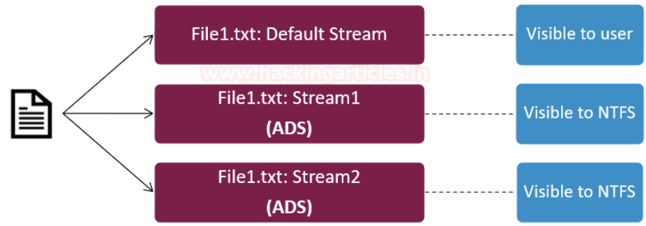
Polymorphic Malware
Malware Protection Using Reverse Engineering
Alternate data streams (ADS) :
Allow Windows files to have hidden, additional data attached to them, which is often used for legitimate purposes but can also be exploited for hiding malicious content.
Pavan-R-Kashyap_Phaneesh-R-Katti_Hrishikesh-Bhat-P_Pranav-K-Hegde

Slide 35
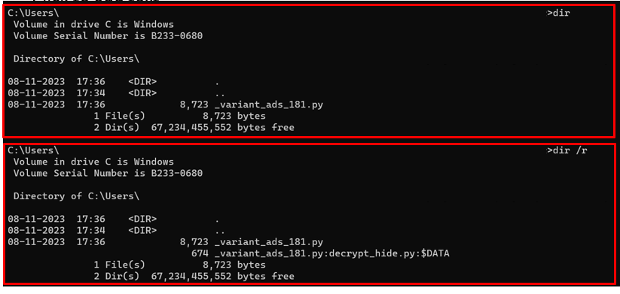
Polymorphic Malware
Malware Protection Using Reverse Engineering
ADS seen on CMD:
Pavan-R-Kashyap_Phaneesh-R-Katti_Hrishikesh-Bhat-P_Pranav-K-Hegde

Slide 36
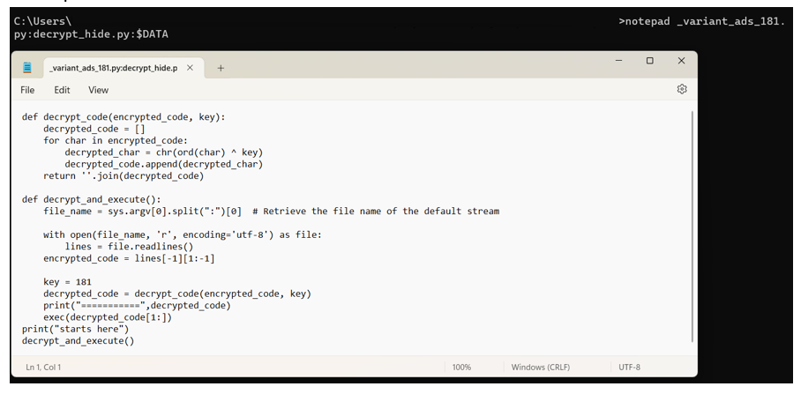
Polymorphic Malware
Malware Protection Using Reverse Engineering
Decryptor Code – 2: (Microsoft does not provide a GUI access to the ADS file)
Pavan-R-Kashyap_Phaneesh-R-Katti_Hrishikesh-Bhat-P_Pranav-K-Hegde

Slide 37
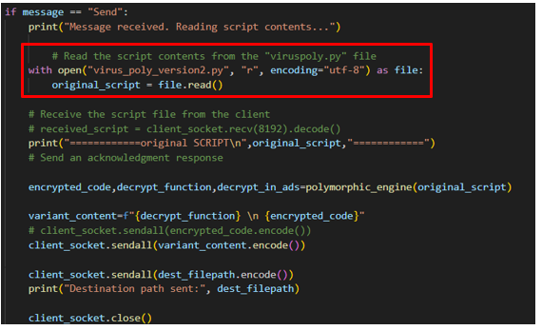
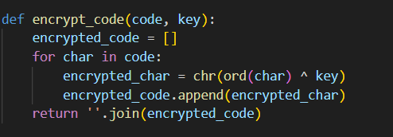
Polymorphic Malware
Malware Protection Using Reverse Engineering
Attacker Side Engine Script and Code Exchange
Pavan-R-Kashyap_Phaneesh-R-Katti_Hrishikesh-Bhat-P_Pranav-K-Hegde

Slide 38
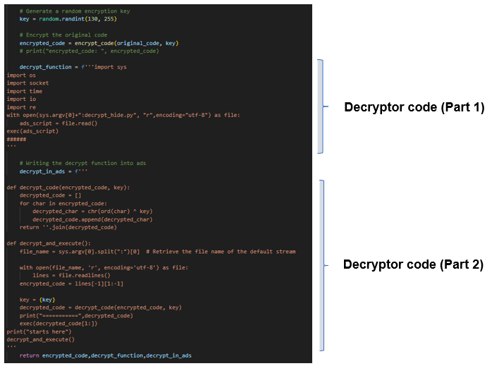
Polymorphic Malware
Malware Protection Using Reverse Engineering
Attacker Side Script
Decryptor Code Part 1
Decryptor Code Part 2
Pavan-R-Kashyap_Phaneesh-R-Katti_Hrishikesh-Bhat-P_Pranav-K-Hegde
Notes:
Please try to add better images

Slide 39
Metamorphic Malware
Malware Protection Using Reverse Engineering
Pavan-R-Kashyap_Phaneesh-R-Katti_Hrishikesh-Bhat-P_Pranav-K-Hegde

Slide 40
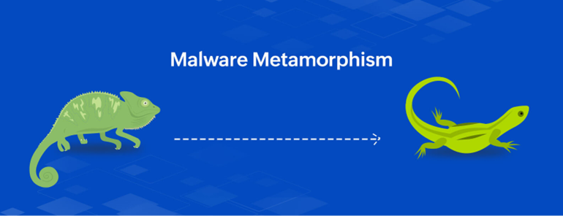
Metamorphic Malware
Malware Protection Using Reverse Engineering
Metamorphic malware samples on the other hand are those malware samples that completely change their code structure, by introducing rabbit holes, to make it difficult for defenders and tools to discern the core functionality of the sample.
The changes are brought about to the core functionality itself, not to the appearance. By deliberately changing the order of assembly instructions or by rearranging the execution of certain code functions in the sample, metamorphic variants aim to thwart behavioral detection.
Pavan-R-Kashyap_Phaneesh-R-Katti_Hrishikesh-Bhat-P_Pranav-K-Hegde

Slide 41
Metamorphic Malware
Malware Protection Using Reverse Engineering
Analogy: The mannequin looks very different every other day. It has a tattooed arm one day, tons of jewellery the other and is an amputee another day.
Metamorphic engines are significantly more complex. They encompass the following entities:
Disassembler-- The disassembler scans through the source code of the sample and identifies the assembly equivalents of the core functionality
Mutation engine -- The mutation engine is responsible for taking the assembly code and introducing mutations and deviations inside it.
Assembler -- Once the original code has been morphed and drastically changed, it is recompiled back so that the new metamorphic variant can be generated.
Pavan-R-Kashyap_Phaneesh-R-Katti_Hrishikesh-Bhat-P_Pranav-K-Hegde

Slide 42
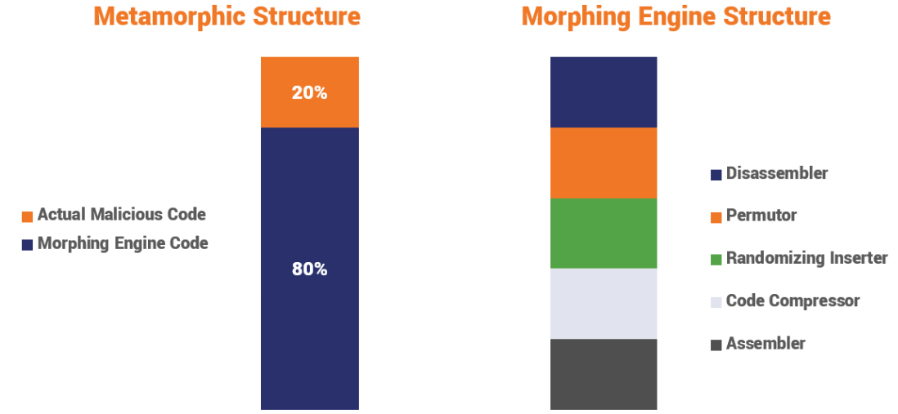
Metamorphic Malware
Malware Protection Using Reverse Engineering
Pavan-R-Kashyap_Phaneesh-R-Katti_Hrishikesh-Bhat-P_Pranav-K-Hegde

Slide 43
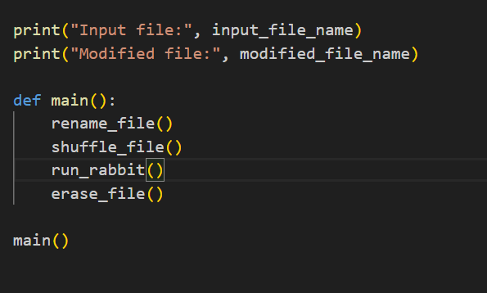
Metamorphic Malware – in Action
Malware Protection Using Reverse Engineering
Pavan-R-Kashyap_Phaneesh-R-Katti_Hrishikesh-Bhat-P_Pranav-K-Hegde

Slide 44
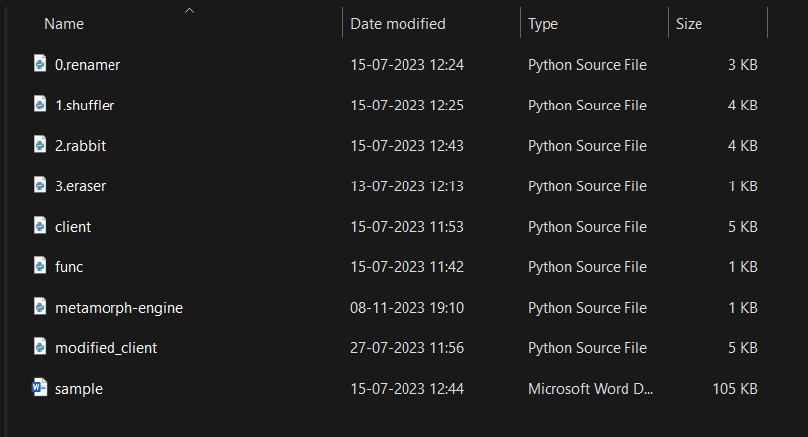
Metamorphic Malware – in Action
Malware Protection Using Reverse Engineering
Pavan-R-Kashyap_Phaneesh-R-Katti_Hrishikesh-Bhat-P_Pranav-K-Hegde

Slide 45
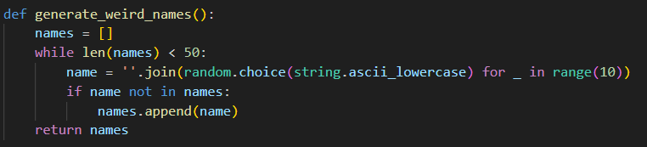
Metamorphic Malware – in Action Renamer
Malware Protection Using Reverse Engineering
Pavan-R-Kashyap_Phaneesh-R-Katti_Hrishikesh-Bhat-P_Pranav-K-Hegde

Slide 46
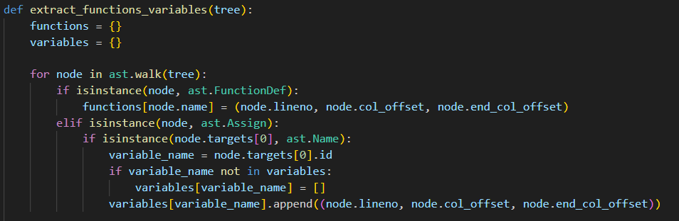
Metamorphic Malware – in Action Renamer
Malware Protection Using Reverse Engineering
Pavan-R-Kashyap_Phaneesh-R-Katti_Hrishikesh-Bhat-P_Pranav-K-Hegde

Slide 47
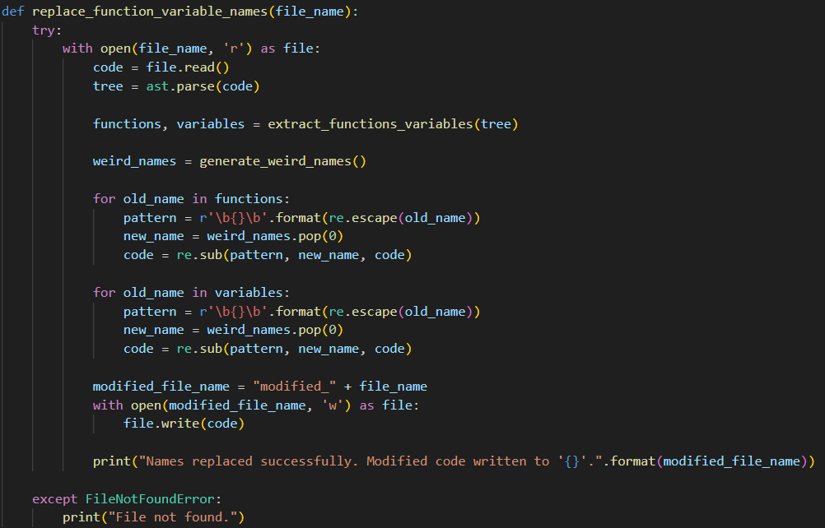
Metamorphic Malware – in Action Renamer
Malware Protection Using Reverse Engineering
Pavan-R-Kashyap_Phaneesh-R-Katti_Hrishikesh-Bhat-P_Pranav-K-Hegde

Slide 48
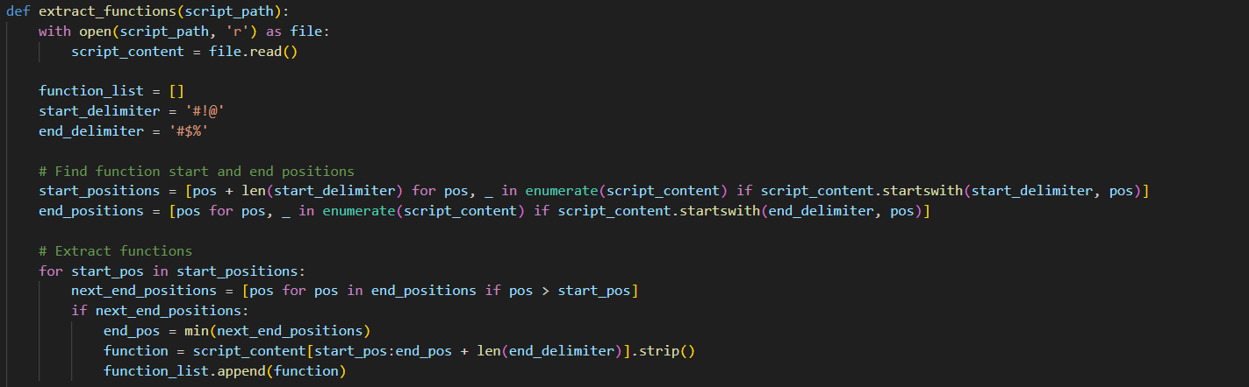
Metamorphic Malware – in Action Shuffler - imports
Malware Protection Using Reverse Engineering
Pavan-R-Kashyap_Phaneesh-R-Katti_Hrishikesh-Bhat-P_Pranav-K-Hegde

Slide 49
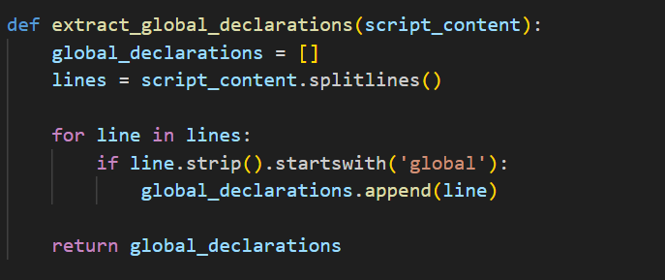
Metamorphic Malware – in Action Shuffler – global declarations
Malware Protection Using Reverse Engineering
Pavan-R-Kashyap_Phaneesh-R-Katti_Hrishikesh-Bhat-P_Pranav-K-Hegde

Slide 50
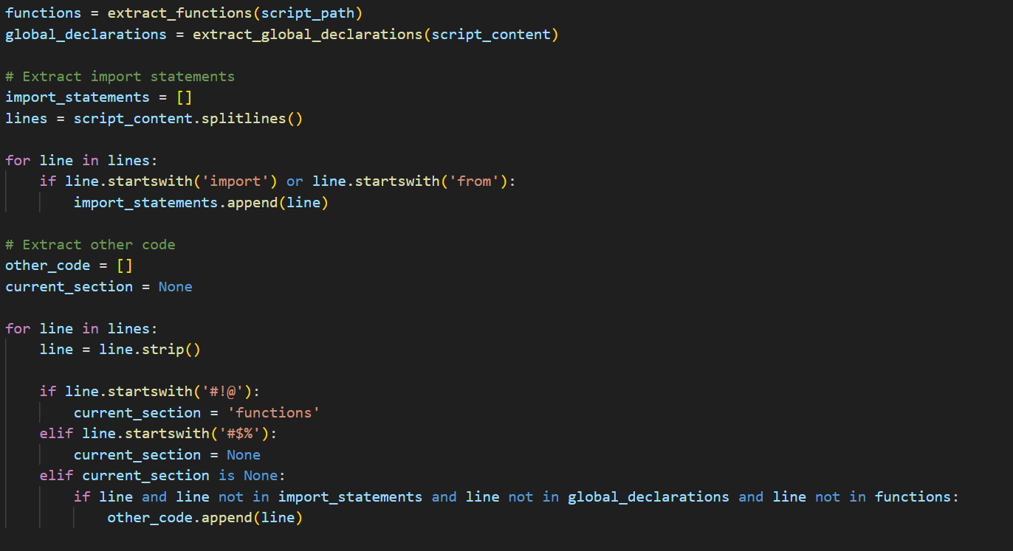
Metamorphic Malware – in Action Shuffler - functions
Malware Protection Using Reverse Engineering
Pavan-R-Kashyap_Phaneesh-R-Katti_Hrishikesh-Bhat-P_Pranav-K-Hegde

Slide 51
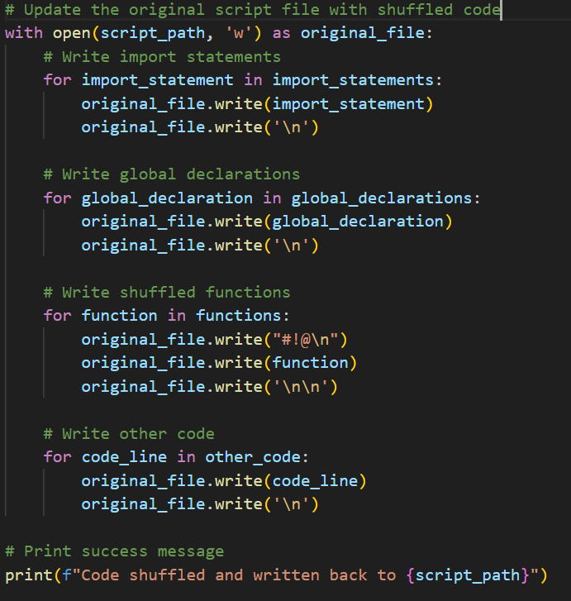
Metamorphic Malware – in Action Shuffler – shuffling
Malware Protection Using Reverse Engineering
Pavan-R-Kashyap_Phaneesh-R-Katti_Hrishikesh-Bhat-P_Pranav-K-Hegde

Slide 52
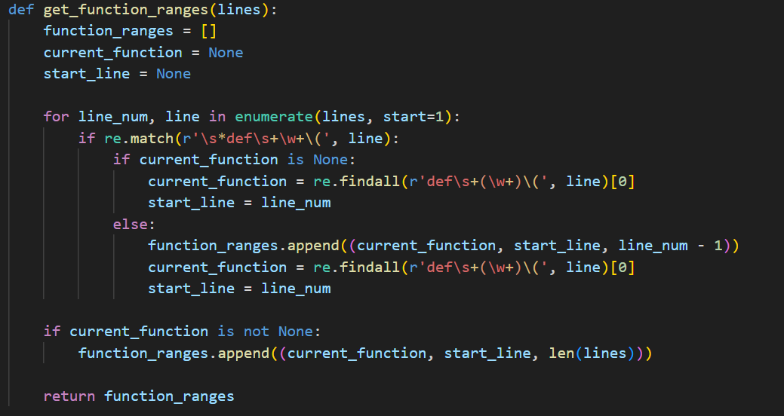
Metamorphic Malware – in Action Rabbitter
Malware Protection Using Reverse Engineering
Pavan-R-Kashyap_Phaneesh-R-Katti_Hrishikesh-Bhat-P_Pranav-K-Hegde

Slide 53
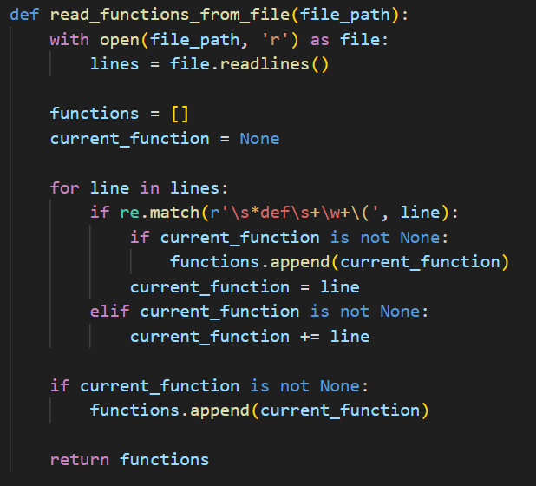
Metamorphic Malware – in Action Rabbitter
Malware Protection Using Reverse Engineering
Pavan-R-Kashyap_Phaneesh-R-Katti_Hrishikesh-Bhat-P_Pranav-K-Hegde

Slide 54
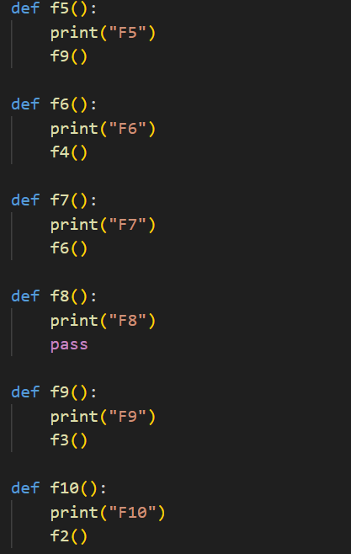
Metamorphic Malware – in Action Func File
Malware Protection Using Reverse Engineering
Pavan-R-Kashyap_Phaneesh-R-Katti_Hrishikesh-Bhat-P_Pranav-K-Hegde

Slide 55
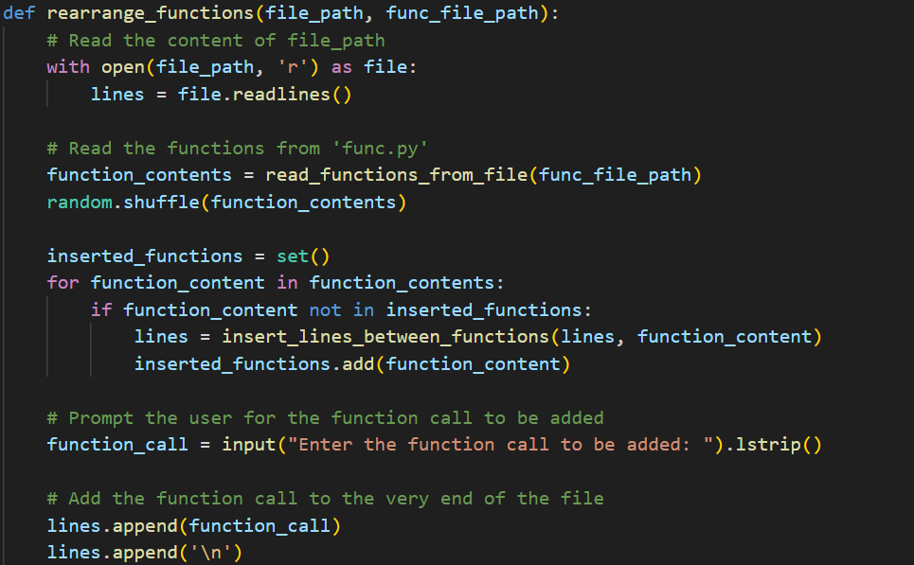
Metamorphic Malware – in Action Rabbitter
Malware Protection Using Reverse Engineering
Pavan-R-Kashyap_Phaneesh-R-Katti_Hrishikesh-Bhat-P_Pranav-K-Hegde

Slide 56
Malware Families
Malware Protection Using Reverse Engineering
Pavan-R-Kashyap_Phaneesh-R-Katti_Hrishikesh-Bhat-P_Pranav-K-Hegde

Slide 57
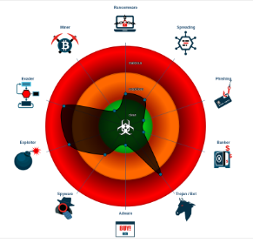
Malware Families – An Introduction
Malware Protection Using Reverse Engineering
Malware families are groups of related malware variants that share common characteristics, code, and behavior.
Families play a crucial role in understanding and combating polymorphic variants of malware.
Pavan-R-Kashyap_Phaneesh-R-Katti_Hrishikesh-Bhat-P_Pranav-K-Hegde

Slide 58
Malware Families – An Introduction
Malware Protection Using Reverse Engineering
Grouping Similar Variants: Families help in grouping based on their commonalities, allowing analysts to see the relationships and identify the underlying malicious code.
Pattern Recognition: By analyzing the structure and behavior of multiple variants within a family, security experts can identify patterns and shared characteristics.
Effective Detection: Rather than detecting individual variants, which can be an endless cat-and-mouse game, detecting an entire family allows for more comprehensive protection against a range of threats.
Mitigation Strategies: Understanding the evolution of polymorphic malware within a family helps in developing better mitigation strategies and producing adaptive defense techniques. Security experts can predict how a malware family is likely to change over time and proactively defend against those changes.
Pavan-R-Kashyap_Phaneesh-R-Katti_Hrishikesh-Bhat-P_Pranav-K-Hegde

Slide 59
General Detection and Mitigation
Malware Protection Using Reverse Engineering
Conventional static detection strategies by Anti viruses are :
Signature-Based Detection: Relies on known patterns or signatures of malware to identify threats. Compares files against a database of known malicious signatures.
Main signature is a hash (unique identifier) of the malware file, typically created through cryptographic algorithms like MD5, SHA-1, or SHA-256.
YARA Rules: Utilizes custom-defined rules to search for specific patterns or characteristics within files, enabling the detection of both known and custom malware variants. These rules can include Hex Strings, IP Addresses, File Size, String Patterns, etc.
Pavan-R-Kashyap_Phaneesh-R-Katti_Hrishikesh-Bhat-P_Pranav-K-Hegde

Slide 60
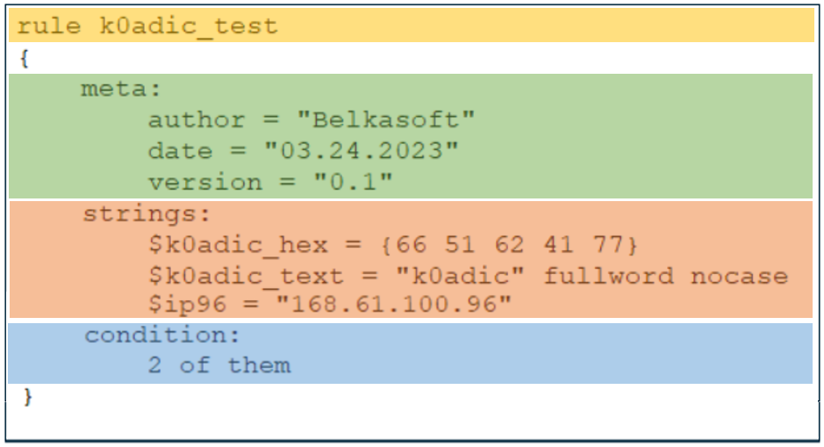
General Detection and Mitigation
Malware Protection Using Reverse Engineering
YARA Rules Format:
Pavan-R-Kashyap_Phaneesh-R-Katti_Hrishikesh-Bhat-P_Pranav-K-Hegde

Slide 61
General Detection and Mitigation
Malware Protection Using Reverse Engineering
Conventional YARA rule generation requires extensive human intervention and expertise.
Yara Generators generate YARA rules (though not precise) for single as well as bulk of malwares automatically thus fastening the process of Yara rule generation.
Automation: Given a set up input files that belong to a given malware family, AutoYara can create Yara rules from the input samples.
Pavan-R-Kashyap_Phaneesh-R-Katti_Hrishikesh-Bhat-P_Pranav-K-Hegde

Slide 62
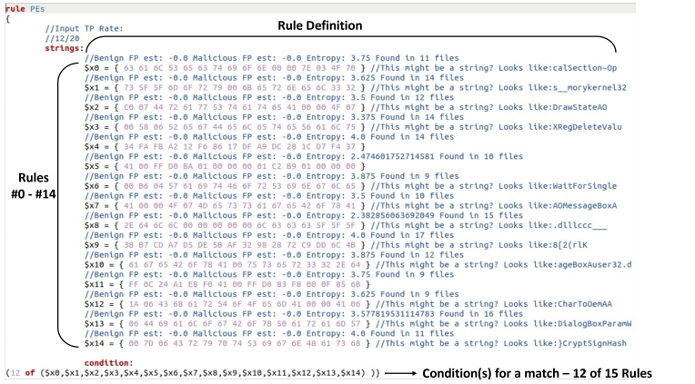
General Detection and Mitigation
Malware Protection Using Reverse Engineering
Pavan-R-Kashyap_Phaneesh-R-Katti_Hrishikesh-Bhat-P_Pranav-K-Hegde

Slide 63
General Detection and Mitigation
Malware Protection Using Reverse Engineering
Limitations of static detection techniques :
Limited to Known Signatures: They are only effective against known malware signatures and cannot detect new or previously unseen threats.
Susceptible to Evasion Tactics: Attackers can easily modify malware to evade static detection by altering signatures, obfuscating code, or using encryption, rendering static techniques less effective in such cases.
Poor at Detecting Fileless Malware: Static detection methods primarily target file-based malware, making them less effective in identifying fileless or memory-resident malware, which doesn't rely on traditional files for execution and is more challenging to detect.
Pavan-R-Kashyap_Phaneesh-R-Katti_Hrishikesh-Bhat-P_Pranav-K-Hegde

Slide 64
Behavioural Rule Generators (BRGs)
Malware Protection Using Reverse Engineering
Pavan-R-Kashyap_Phaneesh-R-Katti_Hrishikesh-Bhat-P_Pranav-K-Hegde

Slide 65
General Detection and Mitigation
Malware Protection Using Reverse Engineering
Behavioural detection -- involves observing or monitoring the dynamic behaviours of the sample to identify if any malicious activities are being initiated.
Ex: Memory manipulation, C2 connections etc.
Sandboxes are one such example of tools that detect dynamic behaviors of a given sample. Sandboxes generate reports highlighting the behaviors observed; they cannot generate behavioural rules for a given malware sample or family.
Pavan-R-Kashyap_Phaneesh-R-Katti_Hrishikesh-Bhat-P_Pranav-K-Hegde

Slide 66
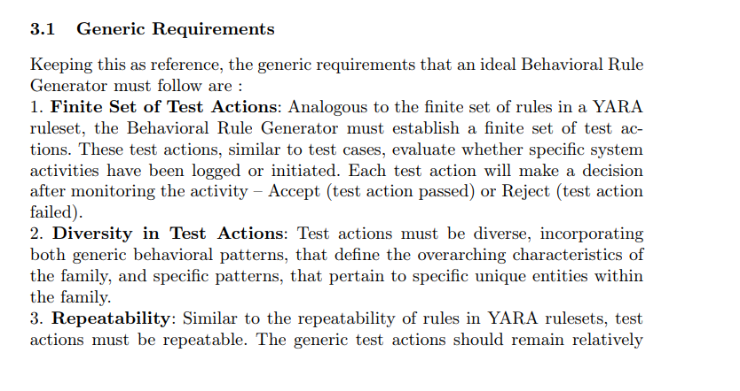
General Detection and Mitigation
Malware Protection Using Reverse Engineering
Behavioral rules, like YARA rules for malware families, allow defenders to observe and monitor the dynamic behaviors of a sample with a given rule-set, to identify if the given sample belongs to the malware family or not.
Pavan-R-Kashyap_Phaneesh-R-Katti_Hrishikesh-Bhat-P_Pranav-K-Hegde

Slide 67
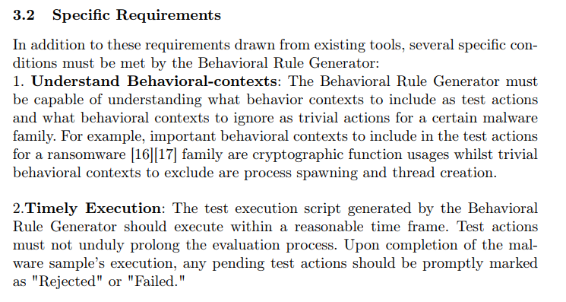
General Detection and Mitigation
Malware Protection Using Reverse Engineering
Pavan-R-Kashyap_Phaneesh-R-Katti_Hrishikesh-Bhat-P_Pranav-K-Hegde

Slide 68
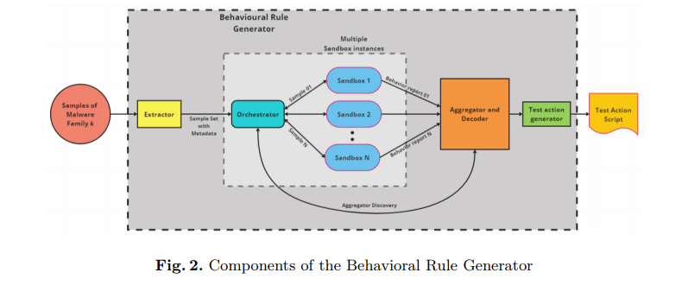
Behavioural Rule Generators Proposed Architecture
Malware Protection Using Reverse Engineering
Pavan-R-Kashyap_Phaneesh-R-Katti_Hrishikesh-Bhat-P_Pranav-K-Hegde

Slide 69
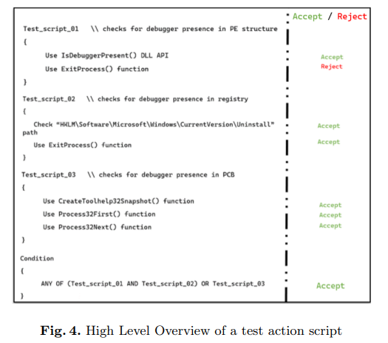
Behavioural Rule Generators Test Action Script
Malware Protection Using Reverse Engineering
Pavan-R-Kashyap_Phaneesh-R-Katti_Hrishikesh-Bhat-P_Pranav-K-Hegde

Slide 70
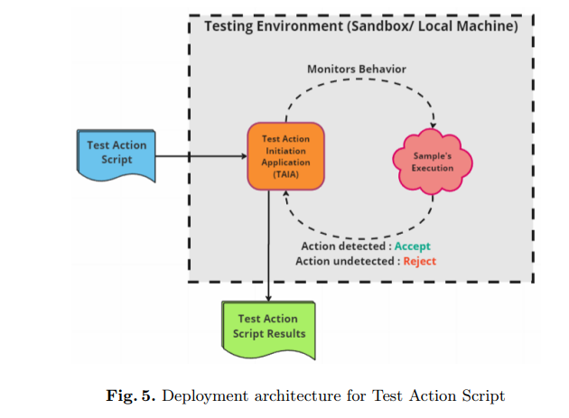
Behavioural Rule Generators Test Environment
Malware Protection Using Reverse Engineering
Pavan-R-Kashyap_Phaneesh-R-Katti_Hrishikesh-Bhat-P_Pranav-K-Hegde

Slide 71
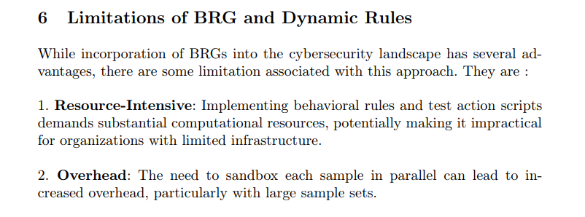
Behavioural Rule Generators Limitations
Malware Protection Using Reverse Engineering
Pavan-R-Kashyap_Phaneesh-R-Katti_Hrishikesh-Bhat-P_Pranav-K-Hegde

Slide 72
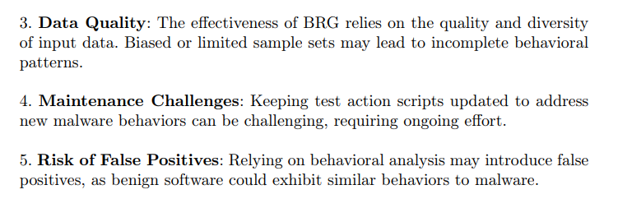
Behavioural Rule Generators Limitations
Malware Protection Using Reverse Engineering
Pavan-R-Kashyap_Phaneesh-R-Katti_Hrishikesh-Bhat-P_Pranav-K-Hegde

Slide 73
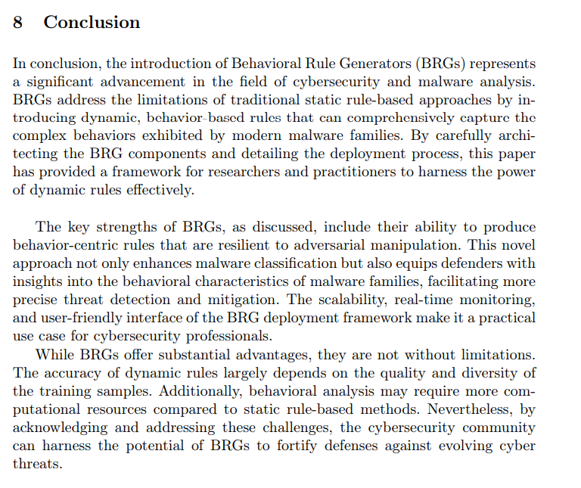
Behavioural Rule Generators
Malware Protection Using Reverse Engineering
Pavan-R-Kashyap_Phaneesh-R-Katti_Hrishikesh-Bhat-P_Pranav-K-Hegde

Slide 74
Clustering
Malware Protection Using Reverse Engineering
Pavan-R-Kashyap_Phaneesh-R-Katti_Hrishikesh-Bhat-P_Pranav-K-Hegde

Slide 75
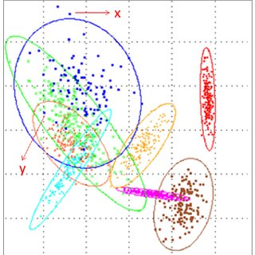
General Detection and Mitigation Polymorphic Malware
Malware Protection Using Reverse Engineering
ML and Clustering:
ML algorithms can classify and detect malware based on patterns and features.
Supervised Learning: Trains models on labeled data to predict malware types.
Unsupervised Learning: Clusters samples based on similarities for malware family analysis
Deep Learning: Utilizes neural networks to analyze large datasets for complex patterns.
Pavan-R-Kashyap_Phaneesh-R-Katti_Hrishikesh-Bhat-P_Pranav-K-Hegde

Slide 76
General Detection and Mitigation Polymorphic Malware
Malware Protection Using Reverse Engineering
Clustering groups similar data points together, making it useful for malware family analysis. It uses ML algorithms like K-Means, Hierarchical Clustering, or DBSCAN to discover patterns. Clustering aids in understanding relationships among malware variants and their evolution.
Features used for clustering and classification:
Static Analysis Features contain File Size, Entropy, Import and Export Functions, API Calls, etc. Dynamic Analysis Features have API Call Sequences, Registry and File System Activity, Text and Code Analysis, Strings, Function Calls, etc. Structural Analysis has Control Flow Graphs (CFG), Data Flow Analysis, File Headers, etc.
Pavan-R-Kashyap_Phaneesh-R-Katti_Hrishikesh-Bhat-P_Pranav-K-Hegde

Slide 77
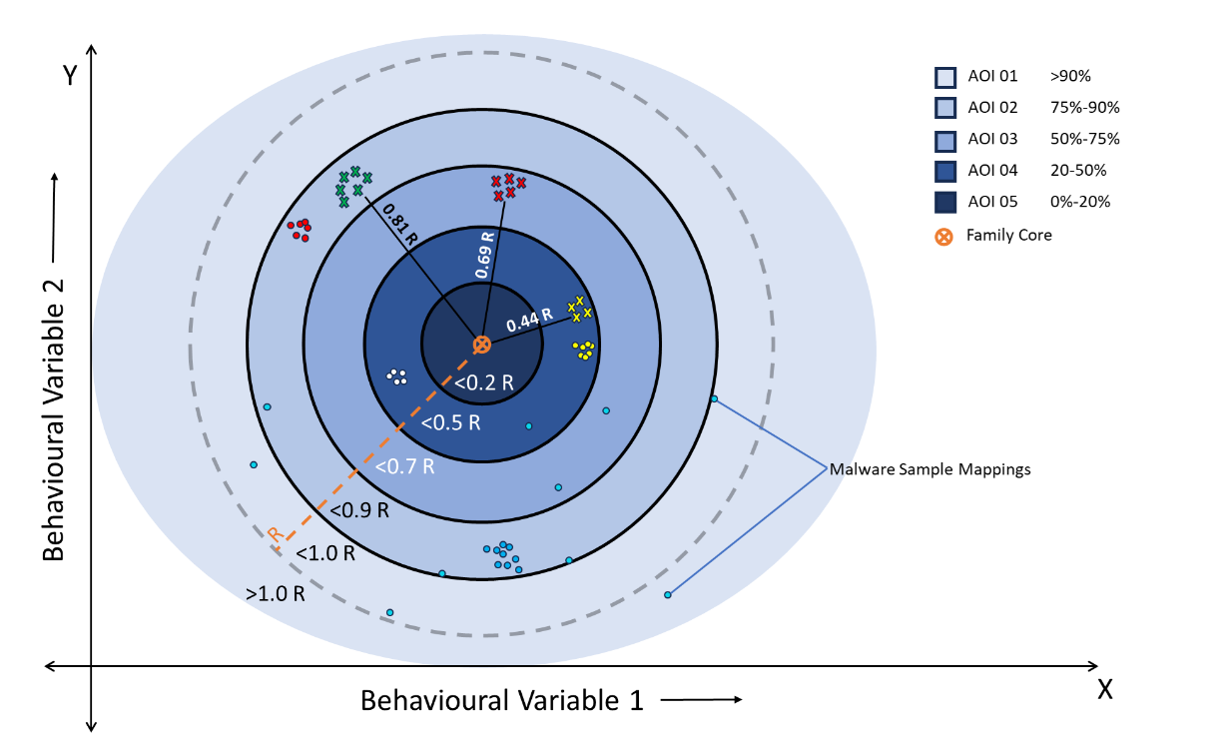
Malware CLustering
Malware Protection Using Reverse Engineering
Pavan-R-Kashyap_Phaneesh-R-Katti_Hrishikesh-Bhat-P_Pranav-K-Hegde

Slide 78
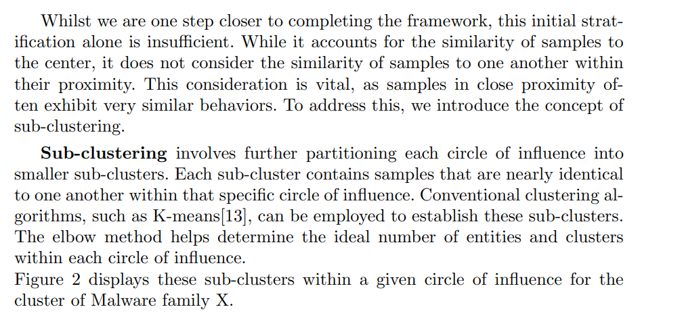
Sub-Clusters
Malware Protection Using Reverse Engineering
Pavan-R-Kashyap_Phaneesh-R-Katti_Hrishikesh-Bhat-P_Pranav-K-Hegde

Slide 79
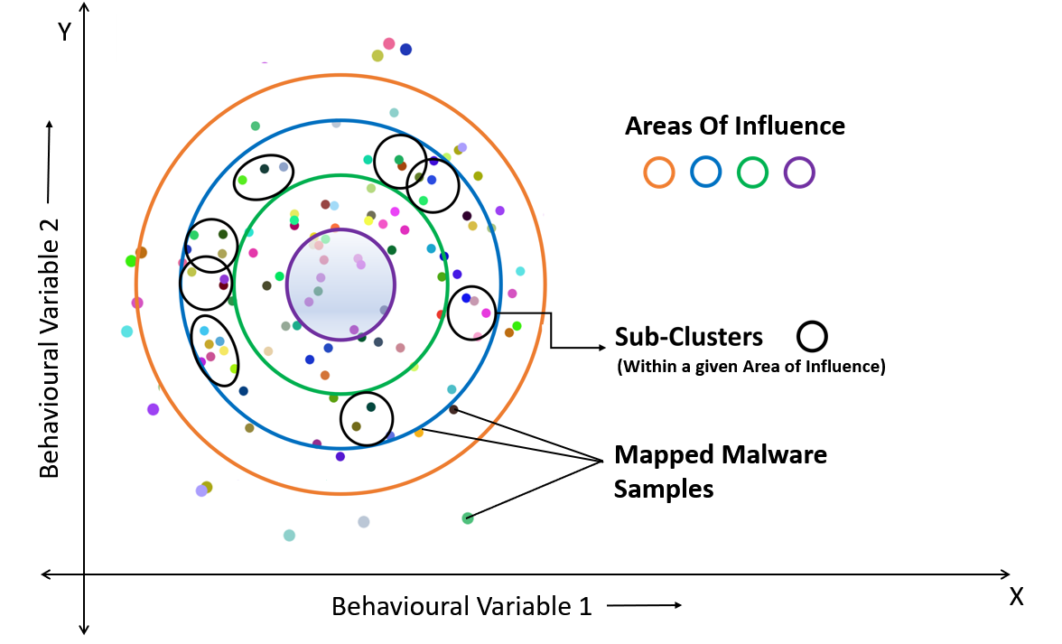
Sub-Clusters
Malware Protection Using Reverse Engineering
Pavan-R-Kashyap_Phaneesh-R-Katti_Hrishikesh-Bhat-P_Pranav-K-Hegde

Slide 80

B-Tree as a Solution Space
Malware Protection Using Reverse Engineering
Pavan-R-Kashyap_Phaneesh-R-Katti_Hrishikesh-Bhat-P_Pranav-K-Hegde

Slide 81

B-Tree Solution Mapping
Malware Protection Using Reverse Engineering
Pavan-R-Kashyap_Phaneesh-R-Katti_Hrishikesh-Bhat-P_Pranav-K-Hegde

Slide 82

Top Level View of Malware Clusters
Malware Protection Using Reverse Engineering
Pavan-R-Kashyap_Phaneesh-R-Katti_Hrishikesh-Bhat-P_Pranav-K-Hegde

Slide 83

Framework In Action
Malware Protection Using Reverse Engineering
Pavan-R-Kashyap_Phaneesh-R-Katti_Hrishikesh-Bhat-P_Pranav-K-Hegde

Slide 84

Framework Limitations - I
Malware Protection Using Reverse Engineering
Pavan-R-Kashyap_Phaneesh-R-Katti_Hrishikesh-Bhat-P_Pranav-K-Hegde

Slide 85


Framework Limitations - II
Malware Protection Using Reverse Engineering
Pavan-R-Kashyap_Phaneesh-R-Katti_Hrishikesh-Bhat-P_Pranav-K-Hegde

Slide 86

Framework Limitations - III
Malware Protection Using Reverse Engineering
Pavan-R-Kashyap_Phaneesh-R-Katti_Hrishikesh-Bhat-P_Pranav-K-Hegde

Slide 87
Metamorphic Malware Mitigation
Malware Protection Using Reverse Engineering
CFG approach : Detects the malware based on the order in which malicious code sequences occur in malware
Code emulation and sandboxing : Emulate the code in a controlled environment to observe its behavior without executing it on the host system. This can help detect malicious activities and code obfuscation.
Regular Expression matching : Develop regular expressions to identify common patterns in metamorphic code, like specific obfuscation techniques or consistent variable naming conventions.
Pavan-R-Kashyap_Phaneesh-R-Katti_Hrishikesh-Bhat-P_Pranav-K-Hegde

Slide 88
Concluding Polymorphic & Metamorphic Malware
Malware Protection Using Reverse Engineering
Polymorphic and Metamorphic malware represent some of the most sophisticated and evasive threats in the cybersecurity landscape. These malware types are continually evolving, employing complex techniques to avoid detection and analysis.
Polymorphic malware alters its code while preserving its original function, while metamorphic malware takes this a step further by completely rewriting its code.
Pavan-R-Kashyap_Phaneesh-R-Katti_Hrishikesh-Bhat-P_Pranav-K-Hegde

Slide 89
Concluding Polymorphic & Metamorphic Malware
Malware Protection Using Reverse Engineering
Both are designed to bypass traditional security measures and complicate the work of cybersecurity professionals. To combat these threats effectively, it is imperative to employ advanced security solutions, heuristic analysis, and machine learning-based approaches that can adapt to the ever-changing nature of polymorphic and metamorphic malware.
The battle against these evolving threats is ongoing, and a multidimensional approach that combines signature-based detection, behavioral analysis, and threat intelligence is essential.
Pavan-R-Kashyap_Phaneesh-R-Katti_Hrishikesh-Bhat-P_Pranav-K-Hegde

Slide 90
Anti-Reverse Engineering Techniques (ARET)
Malware Protection Using Reverse Engineering
Pavan-R-Kashyap_Phaneesh-R-Katti_Hrishikesh-Bhat-P_Pranav-K-Hegde

Slide 91
ARETs
Malware Protection Using Reverse Engineering
Anti-reverse engineering techniques are methods employed by software developers or attackers to protect software applications or malware from being analyzed, decompiled, or disassembled by reverse engineers.
ARETs generally include Code Obfuscation, Encryption, making method call names meaningless or Spaghetti code, Code flow obfuscation, self-modifying code or polymorphism (changing the binary, each time the binary is copied)
Pavan-R-Kashyap_Phaneesh-R-Katti_Hrishikesh-Bhat-P_Pranav-K-Hegde

Slide 92

ARET Example
Malware Protection Using Reverse Engineering
Pavan-R-Kashyap_Phaneesh-R-Katti_Hrishikesh-Bhat-P_Pranav-K-Hegde

Slide 93
Malicious Use of ARETs
Malware Protection Using Reverse Engineering
Obfuscation
Evading Detection
Hiding Exploited Vulnerabilities
Pavan-R-Kashyap_Phaneesh-R-Katti_Hrishikesh-Bhat-P_Pranav-K-Hegde

Slide 94
Malware Protection Using Reverse Engineering
ARETs
Anti-VM & Anti-Sandbox
Anti-Debugging
System checks (CPUID, Registry Checks)
User activity-based checks(Mouse, Temperature, Process Checks)
Time-based evasion, etc.
Related to OS’s handling of debugging
Includes Windows API functions
Checking breakpoints dynamically
Removing hardware breakpoints, a.k.a bugs
Pavan-R-Kashyap_Phaneesh-R-Katti_Hrishikesh-Bhat-P_Pranav-K-Hegde

Slide 95

ARET Example
Malware Protection Using Reverse Engineering
Pavan-R-Kashyap_Phaneesh-R-Katti_Hrishikesh-Bhat-P_Pranav-K-Hegde

Slide 96

ARET₁ – Anti-VM Checking for Virtual Env Artifacts (Host Machine)
Malware Protection Using Reverse Engineering
Pavan-R-Kashyap_Phaneesh-R-Katti_Hrishikesh-Bhat-P_Pranav-K-Hegde

Slide 97

ARET₁ – Anti-VM Checking for Virtual Env Artifacts (Virtual Machine)
Malware Protection Using Reverse Engineering
Pavan-R-Kashyap_Phaneesh-R-Katti_Hrishikesh-Bhat-P_Pranav-K-Hegde

Slide 98

ARET₂ – Anti-VM Access Hardware Information
Malware Protection Using Reverse Engineering
Pavan-R-Kashyap_Phaneesh-R-Katti_Hrishikesh-Bhat-P_Pranav-K-Hegde

Slide 99

ARET₃ – Anti-Sandbox Mouse Movement
Malware Protection Using Reverse Engineering
Pavan-R-Kashyap_Phaneesh-R-Katti_Hrishikesh-Bhat-P_Pranav-K-Hegde

Slide 100
ARET₃ – Anti-Sandbox Mouse Movement
Malware Protection Using Reverse Engineering
Pavan-R-Kashyap_Phaneesh-R-Katti_Hrishikesh-Bhat-P_Pranav-K-Hegde

Slide 101

ARET₄ – Anti-Debugger IsDebuggerPresent()
Malware Protection Using Reverse Engineering
Pavan-R-Kashyap_Phaneesh-R-Katti_Hrishikesh-Bhat-P_Pranav-K-Hegde

Slide 102
ARET₄ – Anti-Debugger IsDebuggerPresent()
Malware Protection Using Reverse Engineering
Pavan-R-Kashyap_Phaneesh-R-Katti_Hrishikesh-Bhat-P_Pranav-K-Hegde

Slide 103
Limitations of Existing Frameworks
Malware Protection Using Reverse Engineering
Lack of Standardization
Diverse Evasion Techniques
Resource Intensive
Subjective Metrics
Incomplete Solution Mapping
Inflexible Metrics
Pavan-R-Kashyap_Phaneesh-R-Katti_Hrishikesh-Bhat-P_Pranav-K-Hegde

Slide 104
Need for Quantification
Malware Protection Using Reverse Engineering
Standardization
Repeatable Solutions
Gauging Threat Levels
Pavan-R-Kashyap_Phaneesh-R-Katti_Hrishikesh-Bhat-P_Pranav-K-Hegde
Notes:
Not convinced with the points

Slide 105
Evasion Techniques
Malware Protection Using Reverse Engineering
Pavan-R-Kashyap_Phaneesh-R-Katti_Hrishikesh-Bhat-P_Pranav-K-Hegde

Slide 106
Evasion Techniques
Malware Protection Using Reverse Engineering
Malware evasion techniques are tactics used by malicious software to avoid detection by security solutions such as antivirus programs, intrusion detection systems, and other security mechanisms.
Evasion Tech v/s ARET:
Anti-reverse engineering techniques are used by malware authors to make it more difficult for security researchers and analysts to understand the inner workings of the malware. These techniques aim to thwart reverse engineering efforts and make it challenging to develop countermeasures.
Pavan-R-Kashyap_Phaneesh-R-Katti_Hrishikesh-Bhat-P_Pranav-K-Hegde

Slide 107
Evasion Technique Varities
Malware Protection Using Reverse Engineering
Trail
Based Obfuscation
Dropper
&
Downloader
Domain Name Generator
Pavan-R-Kashyap_Phaneesh-R-Katti_Hrishikesh-Bhat-P_Pranav-K-Hegde

Slide 108
Evasion Technique Varities
Malware Protection Using Reverse Engineering
Code pings Malicious IP address masked among other random benign-like IP addresses.
Responses can be spoofed by the attacker from these benign IPs to the victim Machine
Trail
Based Obfuscation
Pavan-R-Kashyap_Phaneesh-R-Katti_Hrishikesh-Bhat-P_Pranav-K-Hegde

Slide 109

Trail Based Obfuscation
Malware Protection Using Reverse Engineering
Pavan-R-Kashyap_Phaneesh-R-Katti_Hrishikesh-Bhat-P_Pranav-K-Hegde

Slide 110

Trail Based Obfuscation
Malware Protection Using Reverse Engineering
Code that spoofs ICMP reply packets with random IP addresses as source IP address.
Pavan-R-Kashyap_Phaneesh-R-Katti_Hrishikesh-Bhat-P_Pranav-K-Hegde

Slide 111

Trail Based Obfuscation
Malware Protection Using Reverse Engineering
Pavan-R-Kashyap_Phaneesh-R-Katti_Hrishikesh-Bhat-P_Pranav-K-Hegde

Slide 112

Trail Based Obfuscation
Malware Protection Using Reverse Engineering
Pavan-R-Kashyap_Phaneesh-R-Katti_Hrishikesh-Bhat-P_Pranav-K-Hegde

Slide 113

Trail Based Obfuscation
Malware Protection Using Reverse Engineering
One can refer to the “IP Whois” website to infer about the legitimacy of a given IP Address
For example, RIPE Network is the organization associated with the IP 85.249.71.158 as shows alongside
Pavan-R-Kashyap_Phaneesh-R-Katti_Hrishikesh-Bhat-P_Pranav-K-Hegde

Slide 114
Evasion Technique Varities
Malware Protection Using Reverse Engineering
Dropper
&
Downloader
Domain Name Generator
Pavan-R-Kashyap_Phaneesh-R-Katti_Hrishikesh-Bhat-P_Pranav-K-Hegde

Slide 115
Evasion Technique Varities
Malware Protection Using Reverse Engineering
The Mal Ben dropper is a code sample that drops multiple files (some benign, some malicious) into the victim’s computer to obfuscate traces.
This sample has XORed the URLs that contain the resources and stored in the executable. At runtime they are de-obfuscated and fetched.
Pavan-R-Kashyap_Phaneesh-R-Katti_Hrishikesh-Bhat-P_Pranav-K-Hegde

Slide 116

Dropper-Downloader
Malware Protection Using Reverse Engineering
Pavan-R-Kashyap_Phaneesh-R-Katti_Hrishikesh-Bhat-P_Pranav-K-Hegde

Slide 117
Dropper-Downloader
Malware Protection Using Reverse Engineering
The attacker uses a random function to decide what URL resources to download into the victim’s system
When using a random function, there is a high possibility that the malicious sample may never get downloaded. To prevent that, the attacker introduces seed values to the random functions.
Certain seed values always map to the malicious URL’s position in the URL array. These seed values are used more frequently in the random function so that the possibility of the malicious sample being downloaded on the victim machine is higher.
Pavan-R-Kashyap_Phaneesh-R-Katti_Hrishikesh-Bhat-P_Pranav-K-Hegde

Slide 118

Dropper-Downloader
Malware Protection Using Reverse Engineering
Pavan-R-Kashyap_Phaneesh-R-Katti_Hrishikesh-Bhat-P_Pranav-K-Hegde

Slide 119
Dropper-Downloader
Malware Protection Using Reverse Engineering
The benign samples are all resource intensive actions like Matrix Multiplication, Long sleep codes etc. All the downloaded scripts are executed simultaneously.
This confuses the defender as the defender is unable to identify which samples caused the damage.
Pavan-R-Kashyap_Phaneesh-R-Katti_Hrishikesh-Bhat-P_Pranav-K-Hegde

Slide 120

Dropper-Downloader
Malware Protection Using Reverse Engineering
Pavan-R-Kashyap_Phaneesh-R-Katti_Hrishikesh-Bhat-P_Pranav-K-Hegde

Slide 121


Dropper-Downloader
Malware Protection Using Reverse Engineering
Dropper downloading multiple benign files along with malicious malware.
Before Execution
After Execution
Pavan-R-Kashyap_Phaneesh-R-Katti_Hrishikesh-Bhat-P_Pranav-K-Hegde

Slide 122
Domain Name Generator
Malware Protection Using Reverse Engineering
Domain name generation focuses on dynamically generating domain names at runtime to establish a C2 connection. The attacker establishes these unconventional domain-named C2 servers. The code contains functions written that map to one of these domain servers at run-time.
This dynamic mapping ensures that the defender will not be able to map the malicious C2 server without executing the malicious sample.
The C2 server that the client maps to is not uniform; blocking one C2 server’s IP does not guarantee that the sample’s C2 connections will fail.
Pavan-R-Kashyap_Phaneesh-R-Katti_Hrishikesh-Bhat-P_Pranav-K-Hegde

Slide 123

Domain Name Generator
Malware Protection Using Reverse Engineering
Pavan-R-Kashyap_Phaneesh-R-Katti_Hrishikesh-Bhat-P_Pranav-K-Hegde

Slide 124
Domain Name Generator
Malware Protection Using Reverse Engineering
Ten servers are brought up at different port numbers. Each server has a unique name that is associated with it (that is randomly generated). Seeding the port numbers ensures that the same unique string is generated. Each server runs on a separate thread and responds by dropping the polymorphic virus sample to the victim machine.
The server stays down for 30s after its successfully sent back the sample, pretending to be inactive. This deceives defenders into thinking that the IP address/domain/port is no longer active/functional, when in reality it is not.
Pavan-R-Kashyap_Phaneesh-R-Katti_Hrishikesh-Bhat-P_Pranav-K-Hegde

Slide 125

Dropper-Downloader
Malware Protection Using Reverse Engineering
Pavan-R-Kashyap_Phaneesh-R-Katti_Hrishikesh-Bhat-P_Pranav-K-Hegde

Slide 126
Mitigation Strategies for Evasion Techniques
Malware Protection Using Reverse Engineering
Dynamic Analysis: Malware often uses evasion techniques to avoid detection in static analysis. Conduct dynamic analysis in a controlled environment to observe malware behavior, including its evasion tactics.
CFG : Control flow graphs allow defenders to eliminate decoy code functions and identify core functionality easily.
Threat Intelligence: Stay updated on the latest threat intelligence reports and indicators of compromise (IoC) to recognize known evasion techniques.
Pavan-R-Kashyap_Phaneesh-R-Katti_Hrishikesh-Bhat-P_Pranav-K-Hegde

Slide 127
Mitigation Strategies for Evasion Techniques
Malware Protection Using Reverse Engineering
Documentation: Maintain detailed records of your analysis process, findings, and mitigation strategies. Documentation is invaluable for reference and sharing.
Dynamic API Resolution: Malware may resolve API calls dynamically at runtime, making it harder to identify malicious behavior through static analysis. Analysts need to monitor API calls during execution and may need to hook and unhook some API functions.
<< need to add more based on examples given before >>
Pavan-R-Kashyap_Phaneesh-R-Katti_Hrishikesh-Bhat-P_Pranav-K-Hegde

Slide 128
Control Flow
Malware Protection Using Reverse Engineering
Review - 3
Research Publications
About
Project Abstract and Scope
Our published work
Conclusion & Future Plan
Project Recap
Milestones Accomplished
Our journey so far for Review - 3
What’s next?
Pavan-R-Kashyap_Phaneesh-R-Katti_Hrishikesh-Bhat-P_Pranav-K-Hegde

Slide 129
Control Flow
Malware Protection Using Reverse Engineering
Review - 3
Research Publications
About
Project Abstract and Scope
Our published work
Conclusion & Future Plan
Project Recap
Milestones Accomplished
Our journey so far for Review - 3
What’s next?
Pavan-R-Kashyap_Phaneesh-R-Katti_Hrishikesh-Bhat-P_Pranav-K-Hegde

Slide 130

SSCC’ 23 International Symposium
Malware Protection Using Reverse Engineering
Pavan-R-Kashyap_Phaneesh-R-Katti_Hrishikesh-Bhat-P_Pranav-K-Hegde

Slide 131

Malware Protection Using Reverse Engineering
Pavan-R-Kashyap_Phaneesh-R-Katti_Hrishikesh-Bhat-P_Pranav-K-Hegde

Slide 132

SSCC’ 23 International Symposium
Malware Protection Using Reverse Engineering
Pavan-R-Kashyap_Phaneesh-R-Katti_Hrishikesh-Bhat-P_Pranav-K-Hegde

Slide 133

Malware Protection Using Reverse Engineering
Pavan-R-Kashyap_Phaneesh-R-Katti_Hrishikesh-Bhat-P_Pranav-K-Hegde

Slide 134
Control Flow
Malware Protection Using Reverse Engineering
Review - 3
Research Publications
About
Project Abstract and Scope
Our published work
Conclusion & Future Plan
Project Recap
Milestones Accomplished
Our journey so far for Review - 3
What’s next?
Pavan-R-Kashyap_Phaneesh-R-Katti_Hrishikesh-Bhat-P_Pranav-K-Hegde

Slide 135
Control Flow
Malware Protection Using Reverse Engineering
Review - 3
Research Publications
About
Project Abstract and Scope
Our published work
Conclusion & Future Plan
Project Recap
Milestones Accomplished
Our journey so far for Review - 3
What’s next?
Pavan-R-Kashyap_Phaneesh-R-Katti_Hrishikesh-Bhat-P_Pranav-K-Hegde

Slide 136

USENIX Paper
Malware Protection Using Reverse Engineering
Pavan-R-Kashyap_Phaneesh-R-Katti_Hrishikesh-Bhat-P_Pranav-K-Hegde

Slide 137
Team Member Contributions
Malware Protection Using Reverse Engineering
 | Review 02 | Review 03
Pavan R Kashyap | Macros Process Hooking PowerShell as an Attack Vector | Metamorphic malware Behavioural Rule Generators Stratification of malware clusters
Phaneesh R Katti | Double Pulsar emulation Process Hooking PowerShell as a Defence Mechanism | Polymorphic malware Anti-reverse engineering techniques Web based trail obfuscation
Hrishikesh Bhat P | Macros PowerShell as an Attack Vector Double Pulsar Emulation | Mal-Ben dropper Domain Name Generator Behavioural Rule Generators
Pranav K Hegde | PowerShell as a Defence Mechanism Advanced Fileless Malware 01 Advanced Fileless Malware 02 | Stratification of malware clusters Metamorphic Malware Polymorphic Malware
Pavan-R-Kashyap_Phaneesh-R-Katti_Hrishikesh-Bhat-P_Pranav-K-Hegde

Slide 138
References
Malware Protection Using Reverse Engineering
https://ciosea.economictimes.indiatimes.com/news/security/top-five-malware-detection-evasion-techniques-in-2023/103839267
Cybersecurity and Infrastructure Security Agency, 2021 Top Malware Strains, [online], Last Accessed: 2023, Oct 25, https://www.cisa.gov/news-events/cybersecurityadvisories/aa22-216a
Faridi, Houtan and Srinivasagopalan, Srivathsan and Verma, Rakesh. (2018).”Performance Evaluation of Features and Clustering Algorithms for Malware”.13-22. 10.1109/ICDMW.2018.00010.
Pavan-R-Kashyap_Phaneesh-R-Katti_Hrishikesh-Bhat-P_Pranav-K-Hegde

Slide 139
References
Malware Protection Using Reverse Engineering
Shavit Yosef, (2023, April 18), Accessed 2023, Oct 11, “ RASPBERRY ROBIN: ANTI-EVASION HOW-TO and EXPLOIT ANALYSIS ”, retrieved from https://research.checkpoint.com/2023/raspberryrobin-anti-evasion-how-to-exploit-analysis/
LordNoteworthy. (Accessed 2023, Oct 11). AlKhaser: An Advanced Anti-Analysis Toolkit [Software], GitHub: https://github.com/LordNoteworthy/al-khaser
Zargarov, N. (2023, February 13). Beepin’ Out of the Sandbox: Analyzing a New Extremely Evasive Malware. Minerva Labs.
Pavan-R-Kashyap_Phaneesh-R-Katti_Hrishikesh-Bhat-P_Pranav-K-Hegde

Slide 140
References
Malware Protection Using Reverse Engineering
Itamar Medyoni, (2020, Nov 16). Accessed 2023 Oct 11, “Malware Anti-VM techniques”, Cynet, https://www.cynet.com/attack-techniques-handson/malware-anti-vm-techniques/
L. Xu and M. Qiao, "Yara rule enhancement using Bert-based strings language model," 2022 5th International Conference on Advanced Electronic Materials,Computers and Software Engineering (AEMCSE), Wuhan, China, 2022, pp. 221-224, doi:10.1109/AEMCSE55572.2022.00052.
Pavan-R-Kashyap_Phaneesh-R-Katti_Hrishikesh-Bhat-P_Pranav-K-Hegde

Slide 141
Thank You!

